Slide 1
DIGITAL INTERFACING…

Slide 2
Programmable Parallel Ports and Handshake Input/Output
Most of the available port devices, such as the 8255A on the SDK-86 board, contain two or three ports which can be programmed to operate in one of several different modes
The different modes allow us to use the devices for many common types of parallel data transfer

Slide 3
Digital Interfacing
Methods of parallel data transfer
8255A internal block diagram and system connections
8255A operational modes and initialization
Constructing and sending 8255A control words. (Refer Text Book 2).

Slide 4
Methods of Parallel Data Transfer

Slide 5
1. Simple Input and Output
When we need to get a digital data from a simple switch, such as a thermostat, into a microprocessor, all we have to do is connect the switch to an input port line and read the port
The thermostat data is always present and ready, so we can read it at any time

Slide 6
Likewise, when we need to output data to a simple display device such as an LED, all we have to do is connect the input of the LED buffer on an output port pin and output the logic level required to turn on the light
The LED is always there and ready, so we can send data to it at any time

Slide 7
2. Simple Strobe I/O
In many applications, valid data is present on an external device only at a certain time, so it must be read in at that time
An example of this is the ASCII – encoded keyboard

Slide 8
When a key is pressed, circuitry on the keyboard sends out the ASCII code for the pressed key on eight parallel data lines, and then sends out a strobe signal on another line to indicate that valid data is present on the 8 data lines
You can read in data only when a strobe pulse tells you that the data is valid

Slide 9
For low rates of data transfer, such as from a keyboard to a microprocessor, a simple strobe transfer works well
However, for high-speed data transfer this method doesn’t work, because there is no signal which tells the sending device when it is safe to send the next data byte

Slide 10
3. Single-Handshake I/O
MICRO-
PROCESSOR
PORT
DEVICE
PERIPHERAL
PARALLEL
DATA LINES
STB
ACK

Slide 11
The peripheral outputs some parallel data and sends an STB signal to the microprocessor
The microprocessor detects the asserted STB signal on a polled or interrupt basis and reads in the byte of data
Then the microprocessor sends an Acknowledgement signal (ACK) to the peripheral to indicate that the data has been read and that the peripheral can send the next byte of data

Slide 12
4. Double-Handshake Data Transfer
The circuit connection is same as before
The sending device asserts its STB line low to ask “Are you ready?”
The receiving system raises its ACK line high to say, “I am ready”

Slide 13
The peripheral device then sends the byte of data and raises its STB line high to say, “Here is some valid data for you”
After it has read in the data, the receiving system drops its ACK line low to say, “I have the data, thank you, and I await your request to send the next byte of data”

Slide 14
Implementing Handshake Data Transfer
For handshake data transfer, a microprocessor can determine when it is time to send the next data byte on a polled or on an interrupt basis
The interrupt approach is usually used, because it makes better use of the processor's time
The 8255A can be programmed to automatically receive an STB signal from a peripheral, send an interrupt signal to the processor, and send the ACK signal to the peripheral at the proper times

Slide 15
8255A Internal Block Diagram and System Connections

Slide 16
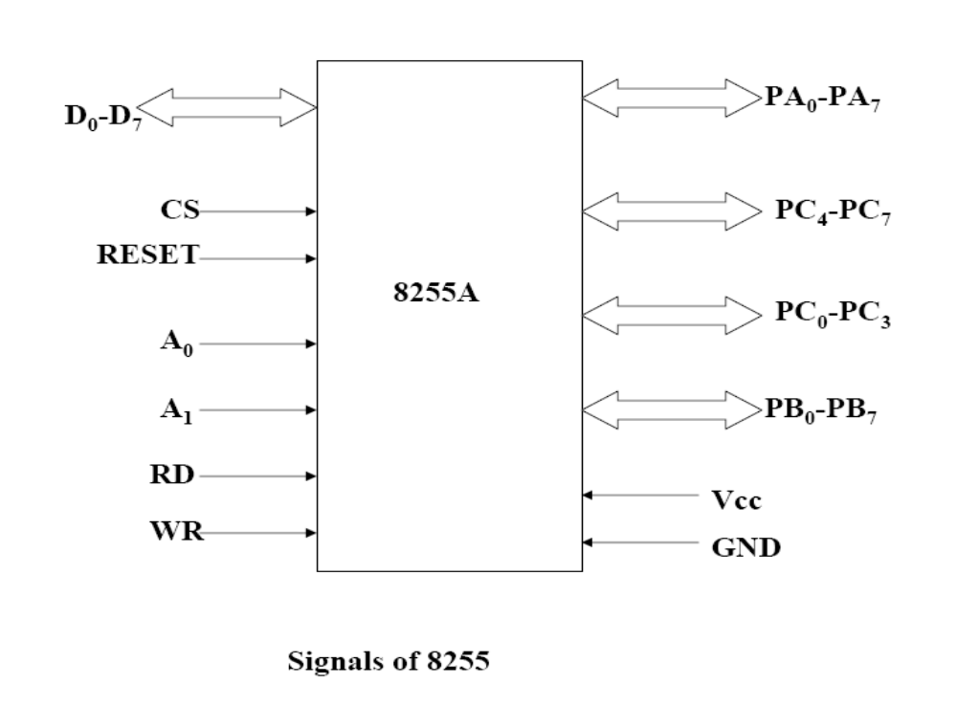

Slide 17
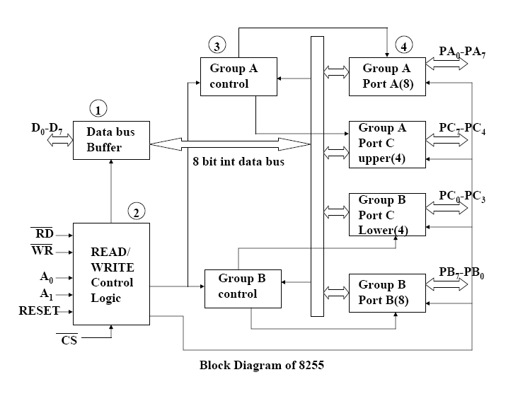

Slide 18
The two groups of I/O pins are named as Group A and Group B
Group A contains an 8-bit port A along with a 4-bit port C upper
The port A lines are identified by symbols PA0-PA7 while the port C lines are identified as PC4-PC7. Similarly, Group B contains an 8-bit port B, containing lines PB0-PB7 and a 4-bit port C with lower bits PC0- PC3
The port C upper and port C lower can be used in combination as an 8-bit port C

Slide 19
All of these ports can function independently either as Input or as Output ports
This can be achieved by programming the bits of an internal register of 8255 called as Control Word Register ( CWR )
The 8-bit data bus buffer is controlled by the Read/Write Control Logic

Slide 20
The read/write control logic manages all of the internal and external transfers of both data and control words
RD, WR, A1, A0 and RESET are the inputs provided by the microprocessor to the READ/ WRITE control logic of 8255

Slide 21
PA7-PA0: These are eight port A lines that acts as either latched output or buffered input lines depending upon the control word loaded into the control word register
PC7-PC4 : Upper nibble of port C lines. They may act as either output latches or input buffers lines. This port also can be used for generation of handshake lines in mode 1 or mode 2

Slide 22
PC3-PC0 : These are the lower port C lines, other details are the same as PC7-PC4 lines
PB0-PB7 : These are the eight port B lines which are used as latched output lines or buffered input lines in the same way as port A
RD : This is the input line driven by the microprocessor and should be low to indicate read operation to 8255
WR : This is an output line driven by the microprocessor. A low on this line indicates write operation

Slide 23
CS : This is a chip select line. If this line goes low, it enables the 8255 to respond to RD and WR signals, otherwise RD and WR signal are neglected
(A0 and A1) Port Select 0 and Port Select 1. These input signals, in conjunction with the RD and WR inputs, control the selection of one of the three ports or the control word register. They are normally connected to the least significant bits of the address bus (A0 and A1).
A1 | A0 | SELECTION
0 | 0 | PORT A
0 | 1 | PORT B
1 | 0 | PORT C
1 | 1 | CONTROL

Slide 24
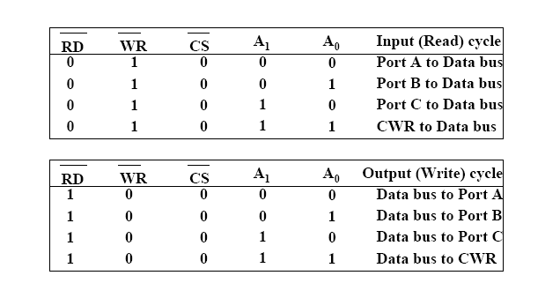

Slide 25
D0-D7 : These are the data bus lines those carry data or control word to/from the microprocessor
RESET : A logic high on this line clears the control word register of 8255. All ports are set as input ports by default after reset.
If port lines are initialized as output after a reset, the port try to output to the output of the device connected to the port. The possible argument b/n the two outputs may destroy one or both of them, therefore all the ports are initialized as input after reset

Slide 26
8255A Operational Modes and Initialization
These are two basic modes of operation of 8255. I/O mode and Bit Set-Reset mode (BSR).
In I/O mode, the 8255 ports work as programmable I/O ports, while in BSR mode only port C (PC0-PC7) can be used to set or reset its individual port bits.
Under the I/O mode of operation, further there are three modes of operation of 8255, so as to support different types of applications, mode 0, mode 1 and mode 2

Slide 27
MODE 0
When you want to use a port for simple I/O without handshaking, you initialize that port in mode 0.
Two 8-bit ports ( port A and port B )and two 4-bit ports (port C upper and lower ) are available. The two 4-bit ports can be combined and used as a third 8-bit port
Any port can be used as an input or output port
The two halves of port C are independent, so one half can be initialized as input, and the other half initialized as output

Slide 28
Mode 1 – Strobed Input
Mode 1 operation causes port A and/or port B to function as latching or strobed input devices
This allows external data to be stored into the port until the microprocessor is ready to retrieve it
Port C is also used in Mode 1 operation, not for data, but for control or handshaking signals that help operate either or both port A and port B as strobed input ports

Slide 29
The strobed input port captures data from the port pins when the strobe (STB) is activated
The STB signal causes data to be captured in the port and also activates the IBF (Input Buffer Full) and INTR (Interrupt Request) signals
Once the microprocessor, through software (IBF) or hardware (INTR), notices that data are strobed into the port, it executes an IN instruction to read the port

Slide 30
The act of reading the port restores both IBF and INTR to their inactive states until the next data is strobed into the port

Slide 32
Timing Diagram – Mode 1 Strobed Input

Slide 33
Out of 8-bit port C, PC0-PC2 are used to generate control signals for port B and PC3-PC5 are used to generate control signals for port A. the lines PC6, PC7 may be used as independent data lines

Slide 34
Mode 1 – Strobed Output
Whenever data are written to a port programmed as a strobed output port, the OBF (Output Buffer Full) signal becomes a logic 0 to indicate that data are present in the port latch
This signal indicates that data are available to an external I/O device that removes the data by strobing the ACK (acknowledge) input to the port
The ACK signal returns the OBF signal to logic 1, indicating that the buffer is not full

Slide 37
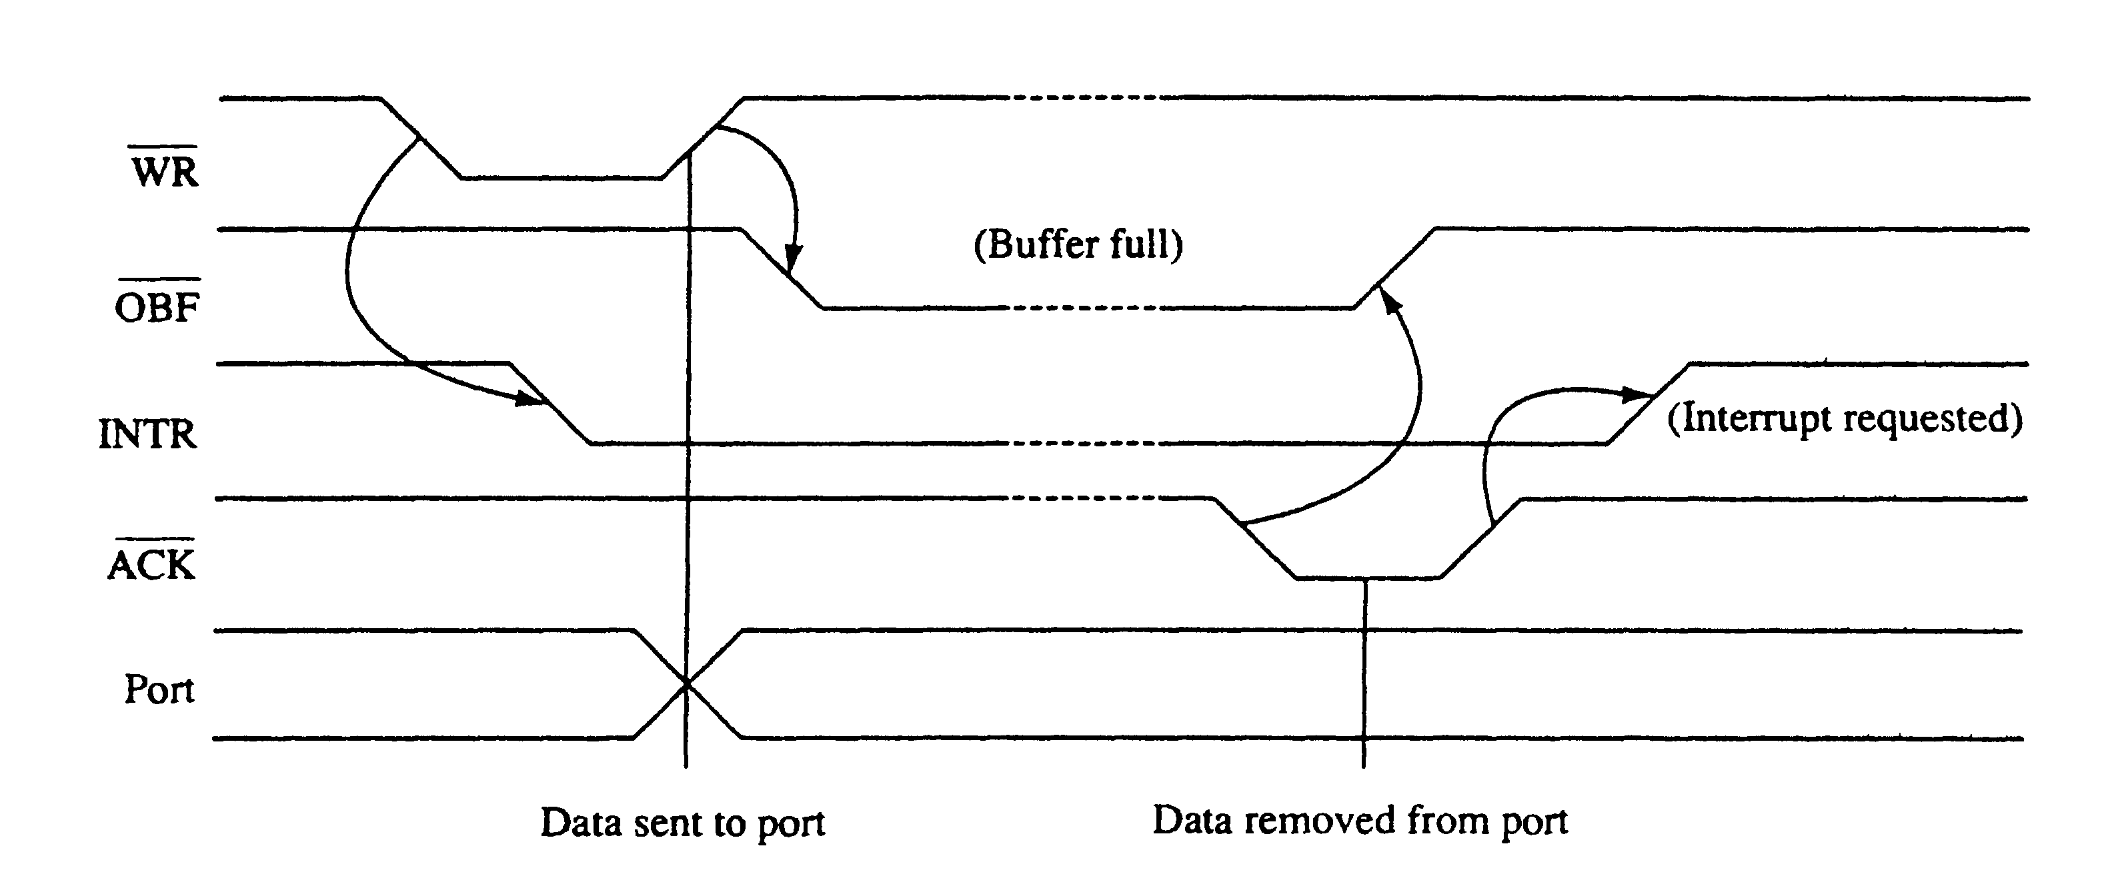
Timing Diagram - Mode 1 Strobed Output

Slide 38
Mode 2 – Bidirectional operation
In mode 2, which is allowed with group A only, port A becomes bidirectional, allowing data to be transmitted and received over the same eight wires
Bi-directional bused data are useful when interfacing two computers

Slide 40
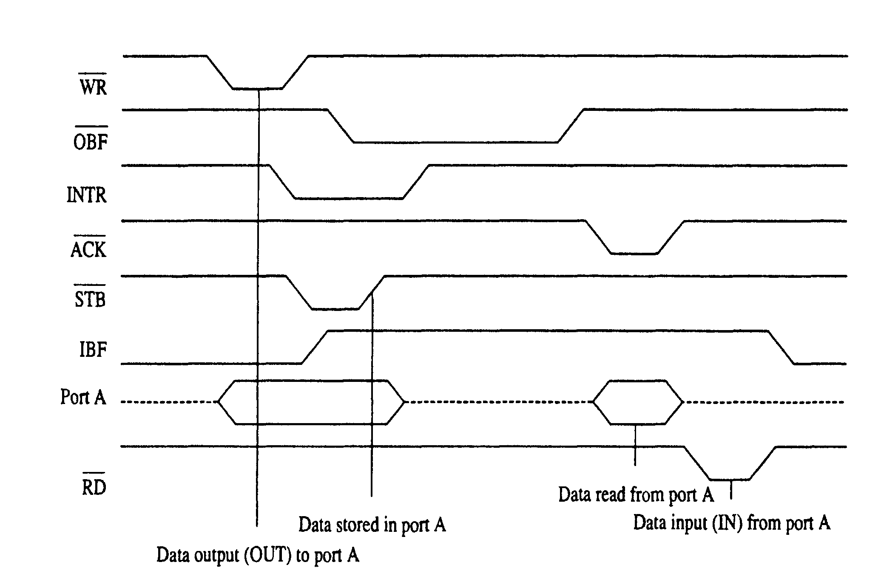
Timing Diagram - Mode 2

Slide 41
To transmit data through the bi-directional bus, the program first tests the OBF signal to determine whether the output buffer is empty
If it is, then data are sent to the output buffer via the OUT instruction
As soon as the output circuitry sees a logic 0 on OBF, it sends back the ACK signal to remove it from the output buffer
The ACK sets the OBF bit

Slide 42
The external interface sends the data into the port using the STB signal
To receive data through the bi-directional port A bus, the IBF bit is tested with software to decide if data have been strobed into the port
If IBF = 1, then the data are input using the IN instruction
When the IN instruction executes, the IBF bit is cleared and the data in the port are moved into AL

Slide 43
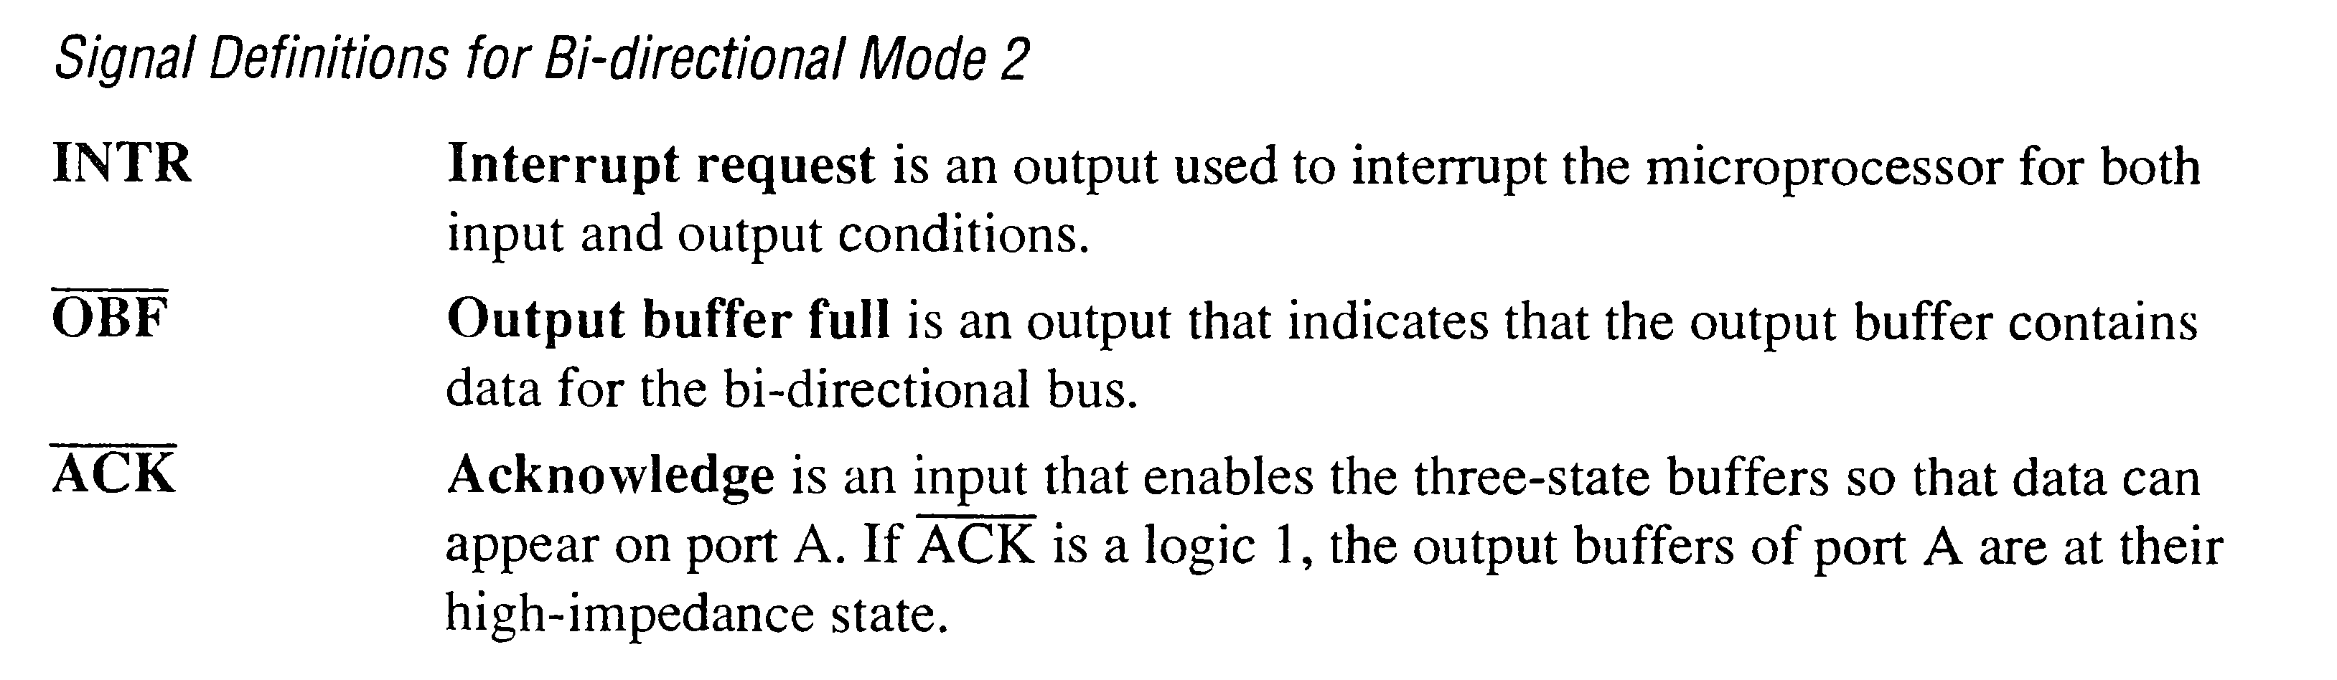

Slide 45
Constructing and Sending
8255A Control Words

Slide 46
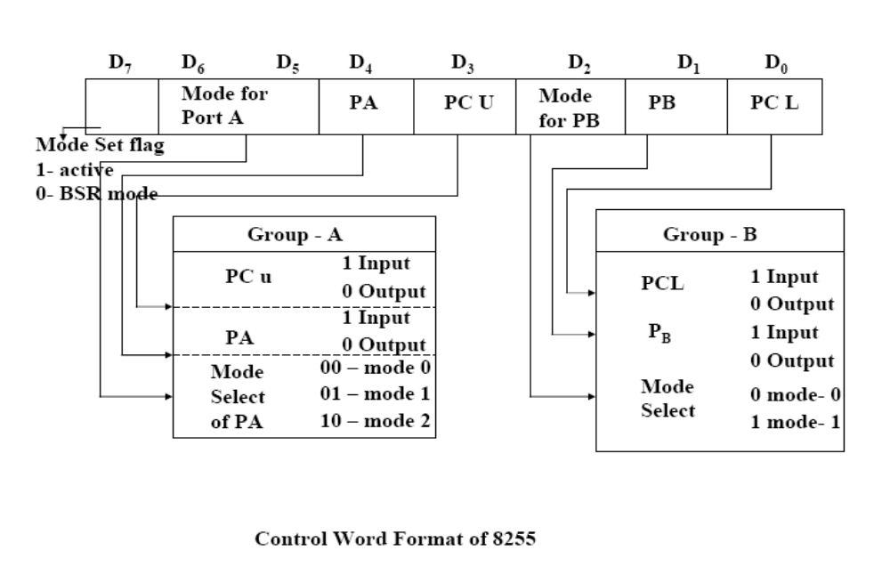
MODE SET CONTROL WORD

Slide 47
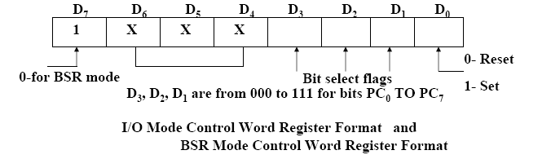
BIT SET / RESET CONTROL WORD

Slide 48
To send this control word to the 8255A, load it into AL, Point DX at the control register address if DX is not already pointing to there, and send the control word with the OUT DX, AL instruction

Slide 49
Logic Controller
7 Segment Display
Stepper Motor
DAC
KeyPad
Elevator
Refer Lab Programs and the theory explained in the Lab…

Slide 50
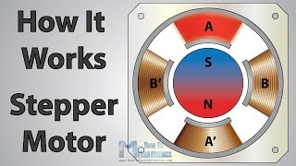
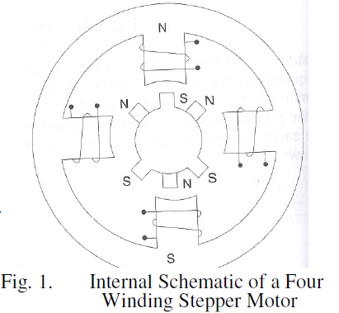
Stepper motor interface

Slide 51
A-PA0
B-PA3
A’- PA2
B’-PA1
When current is passed through PA0 the electro magnet is excited. The needle will point to this electromagnet.(PA3,PA2,PA1,PA0 are 0001)
whenever a current is passed through PA3 the electro magnet is excited. The needle will point to this electromagnet(PA3).(PA3,PA2,PA1,PA0 are 1000)
This makes needle to move 90⁰ there by making one full step.

Slide 52

To make a movement smooth both PA0 and PA3 are excited so that needle moves by 45⁰
There by making half step. Then PA3 is excited to make a rotation of 90⁰ (one fullstep).
For one full step of rotation stepper motor shaft moves by 1.8⁰
To move stepper motor shaft by ɵ⁰ the number of moves =
Example: to move stepper motor shaft by 90⁰ the number of moves =90/1.8=50 full steps

Slide 53

PA3 | PA2 | PA1 | PA0
0 | 0 | 0 | 1
1 | 0 | 0 | 1
0 | 0 | 0 | 1
1 | 1 | 0 | 0
0 | 1 | 0 | 0
0 | 1 | 1 | 0
0 | 0 | 1 | 0
0 | 0 | 1 | 1
0 | 0 | 0 | 1

Slide 54
3*8 Key pad Interface
PC0,PC1 and PC2 are used as output ports to pass current
PA0 to PA7 are used as input ports to check which key is pressed.
Assume that the user has pressed the key 2.the switch will connect the line from PC0 to PA2 and there will be a flow of current through PA2 so the bit PA2 will be 1 ans remaining will be zero
the logic is to pass current for thr first row and check if any key is pressed there. If PA0-PA7 are 0’s then that indecates no key is pressed in first row. The current is passed to second row by making PC1 as high.
If any key is pressed then any one bit from PA0-PA7 will be set to one

Slide 55
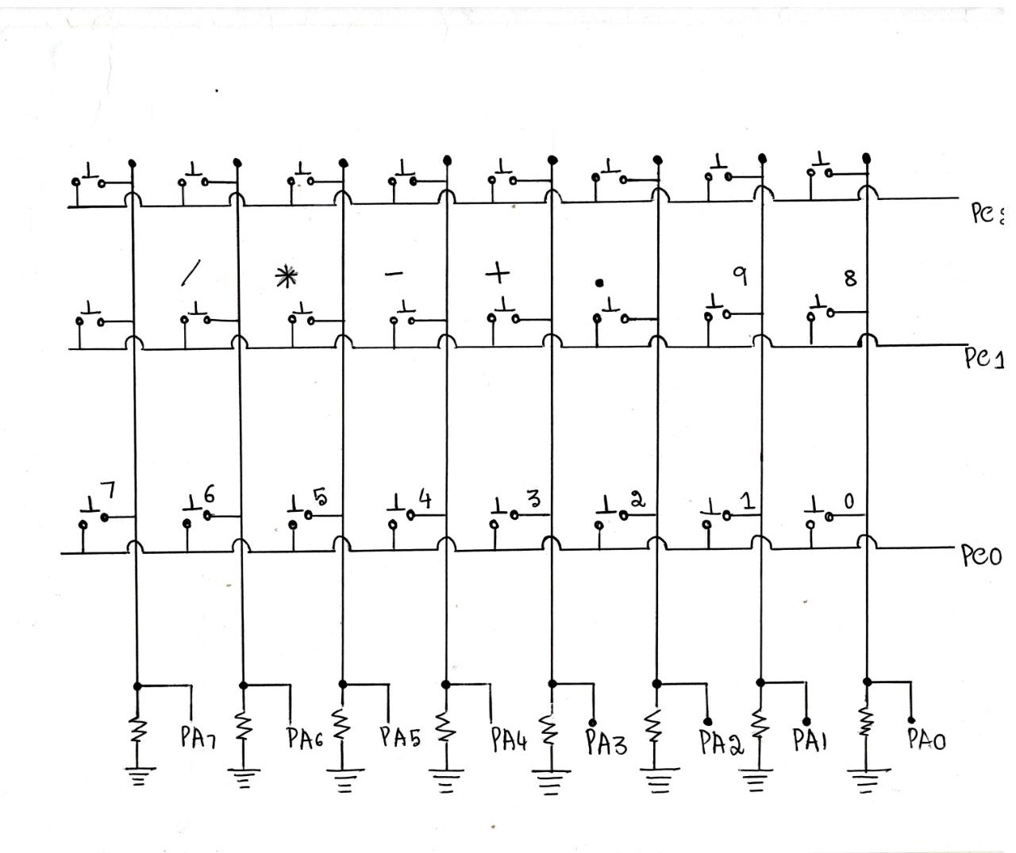

Slide 56
Thank You…

